Slide 1
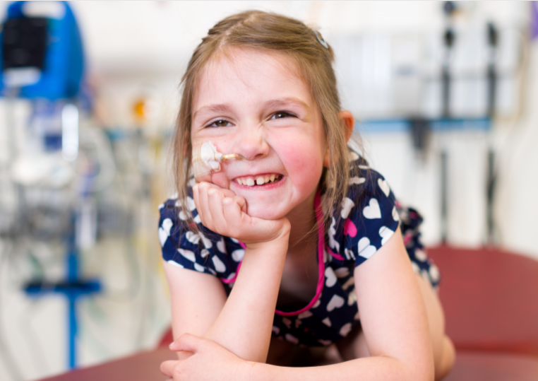


Thank you
{NAME}
For Taking on The Glasgow Kiltwalk 2022!
You Have Raised an Incredible
{AMOUNT}

